Slide 1
TransitTree
Less driving, more thriving

Slide 2
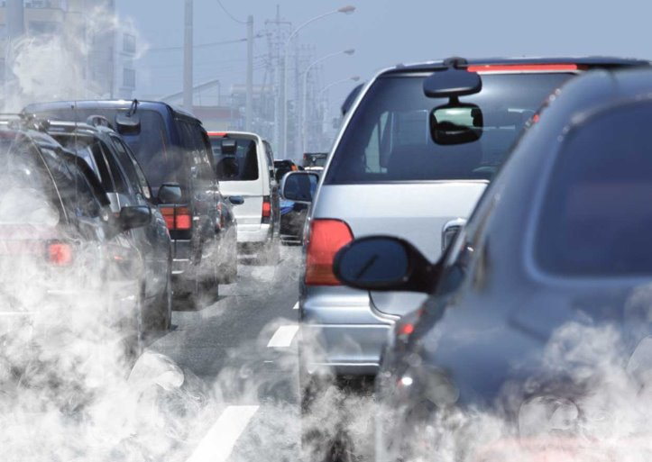
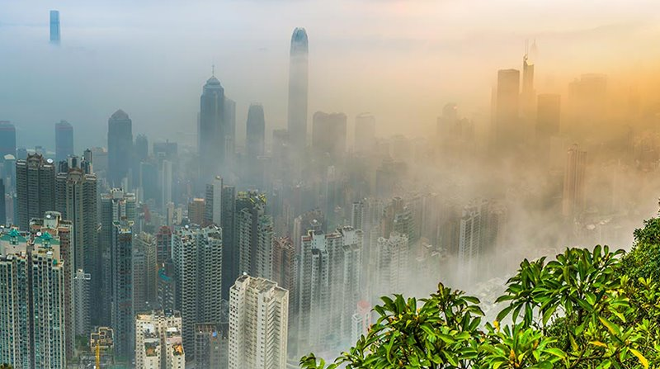
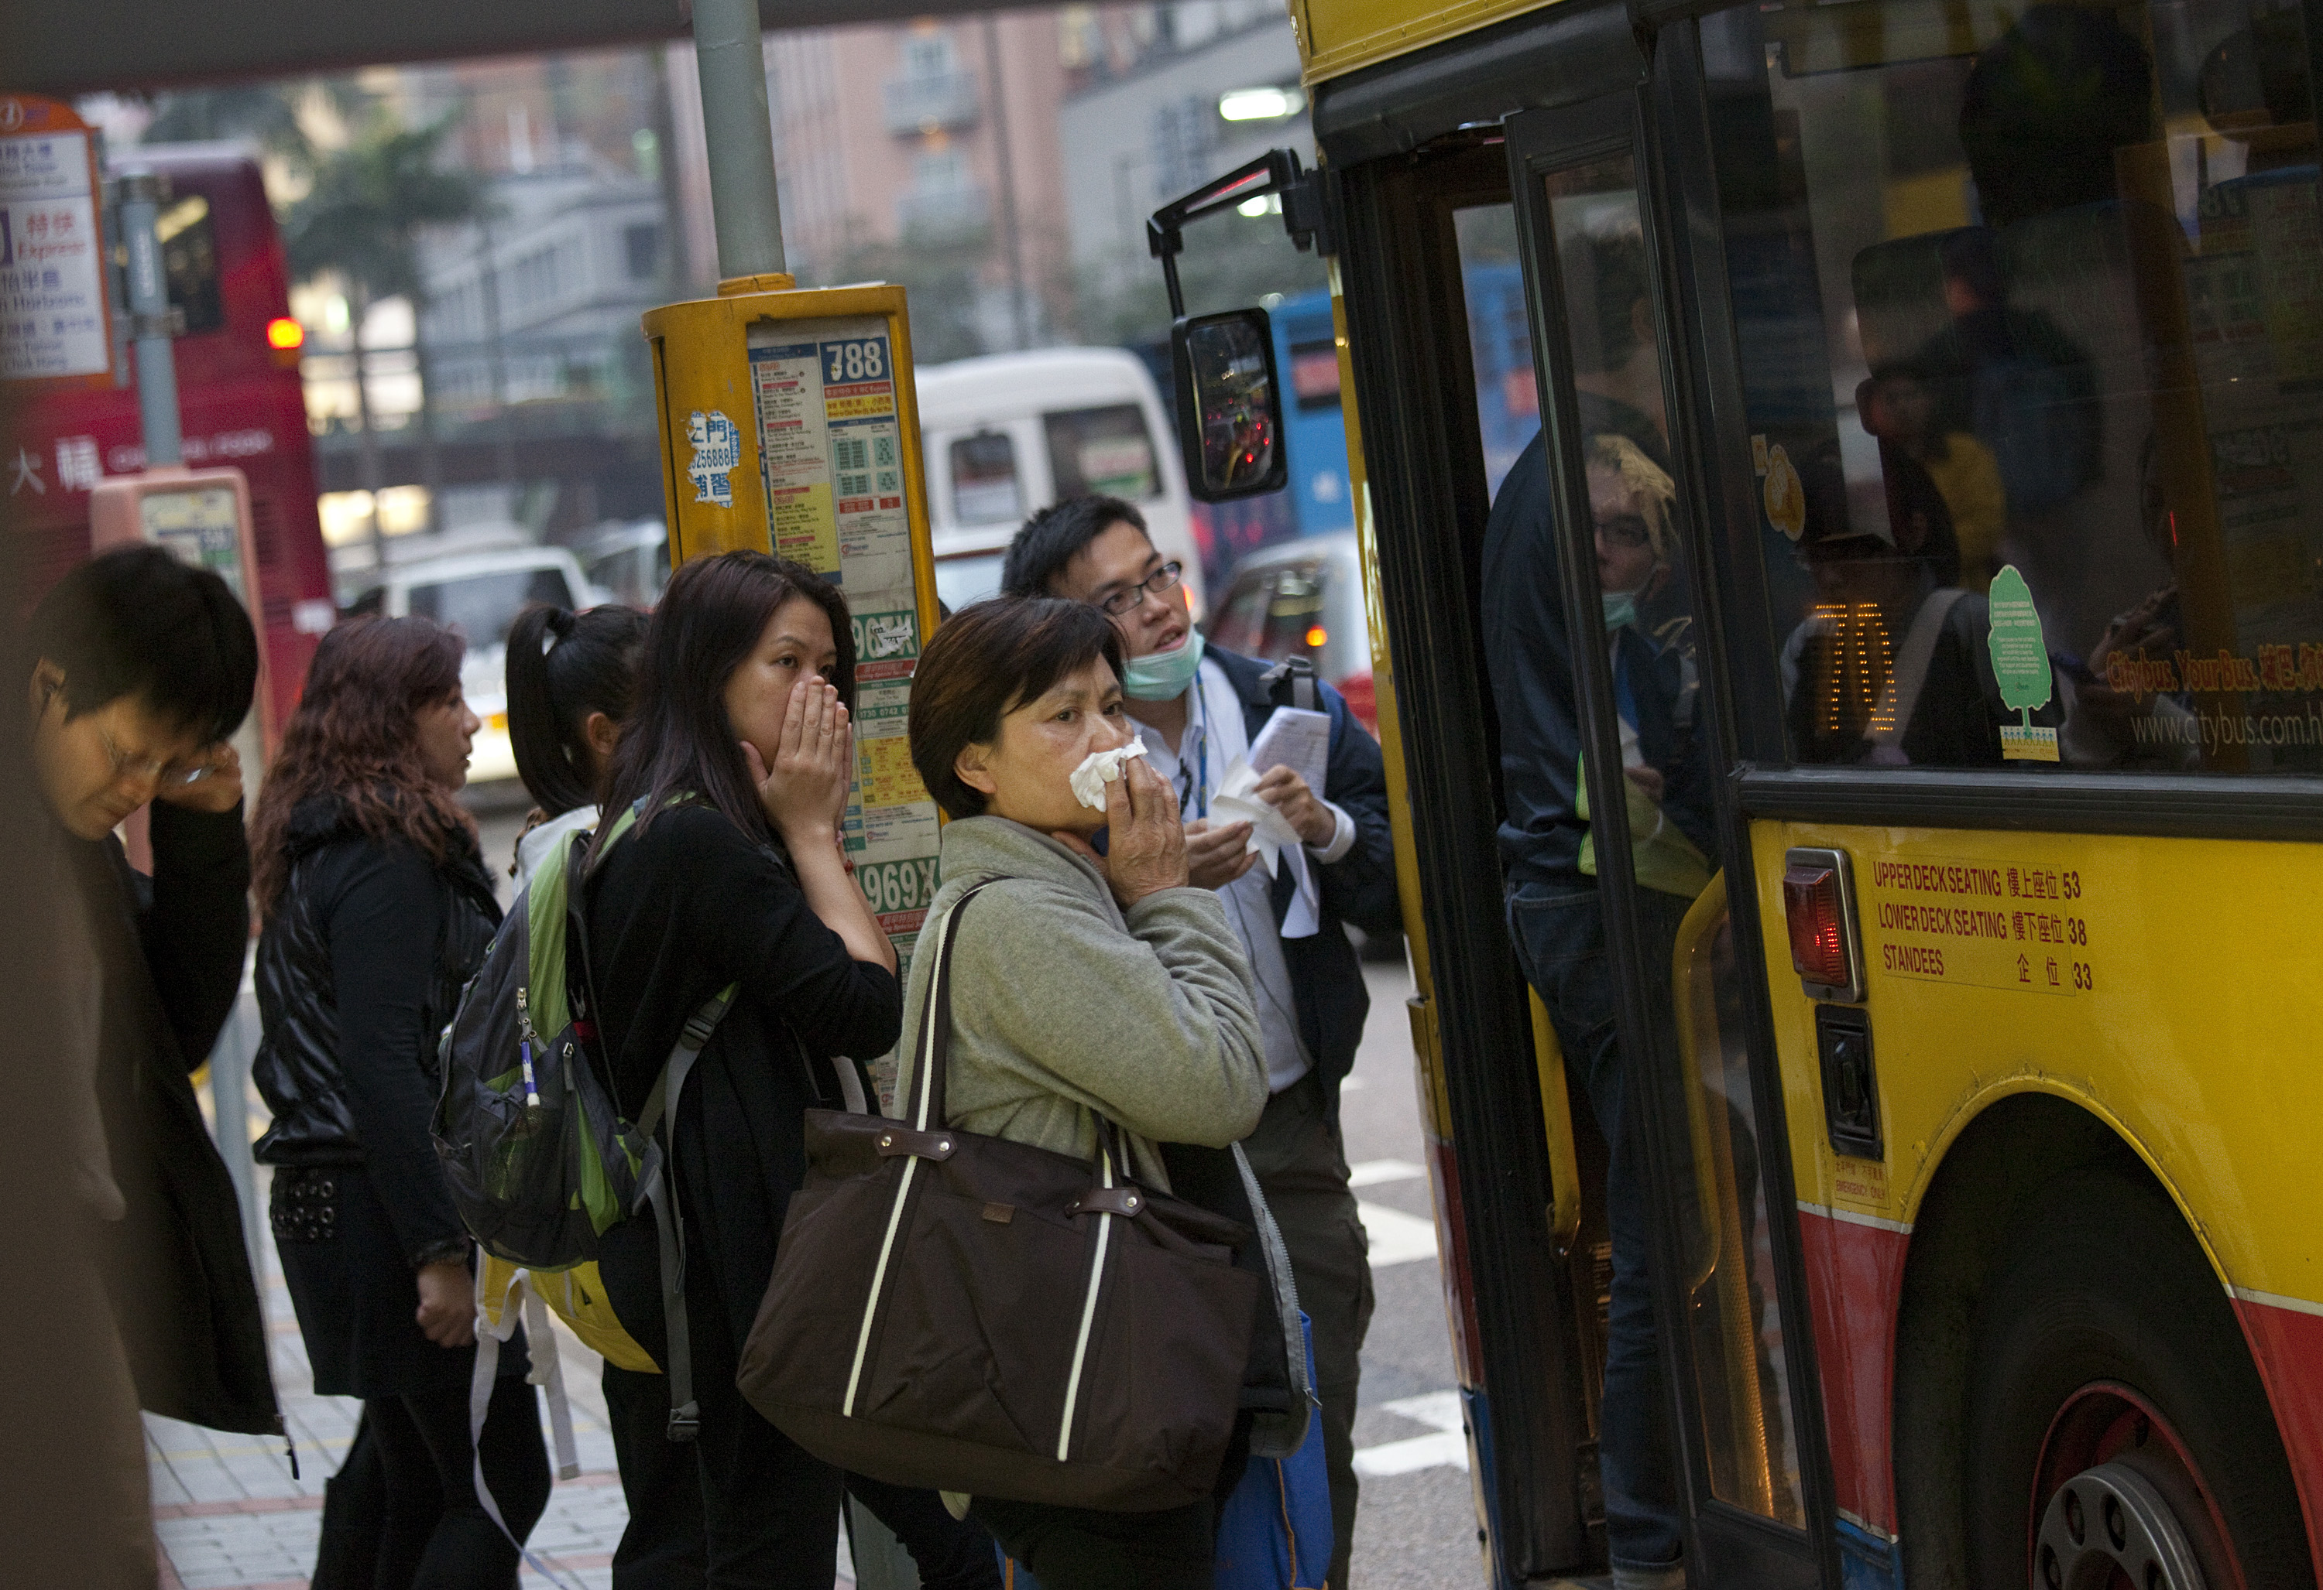

Slide 3
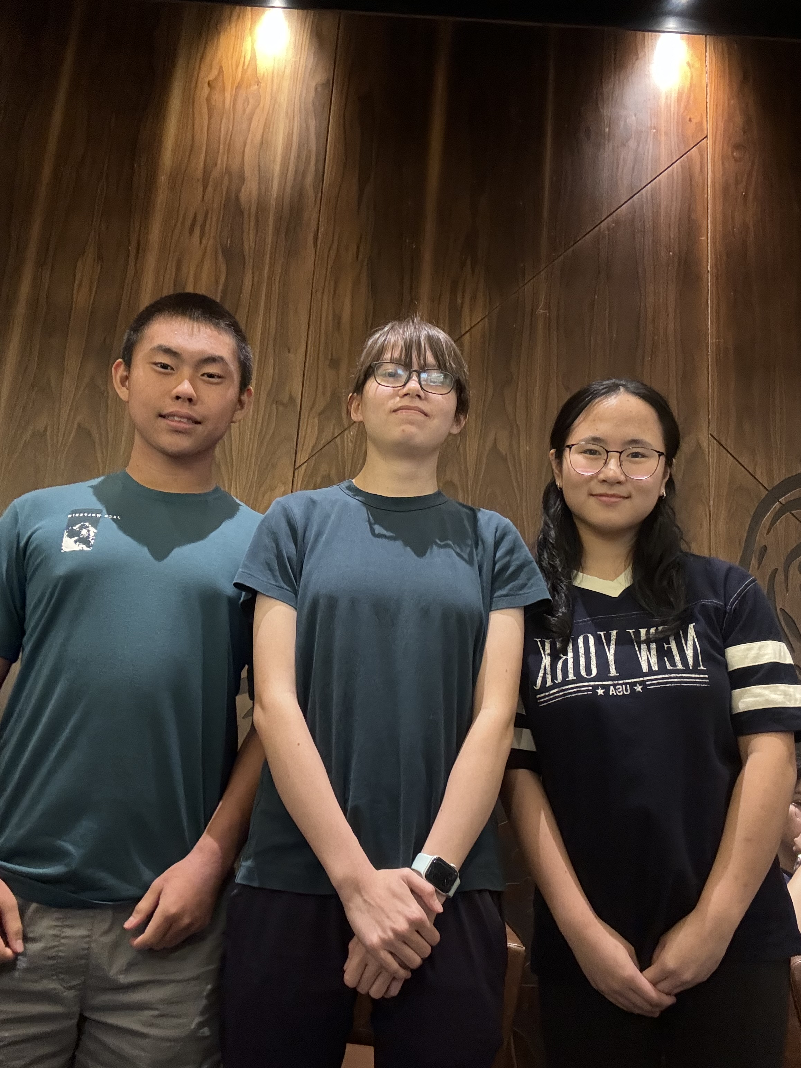
The Team

Slide 4
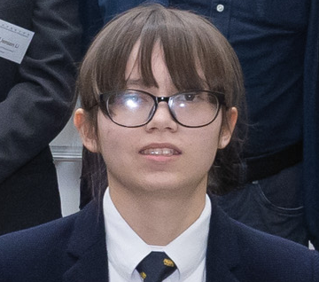
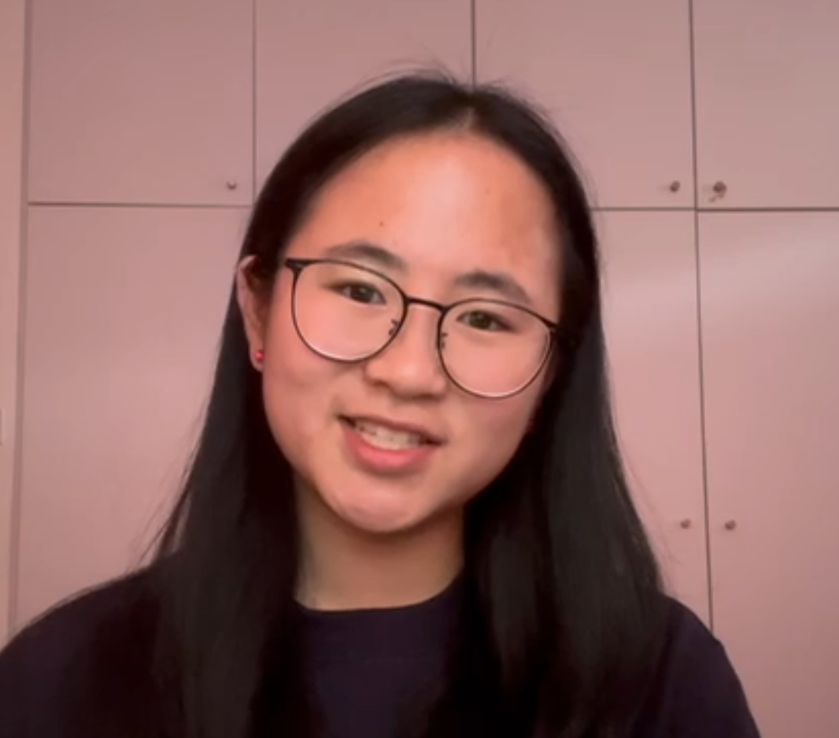
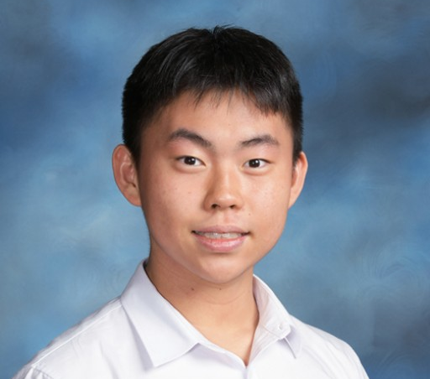
Our Team
Valentina Banner
Maya Yan
Kylton Kim
Developer
Designer /
Idea Developer
Idea Owner

Slide 5
01
Introduction: The Issue

Slide 6
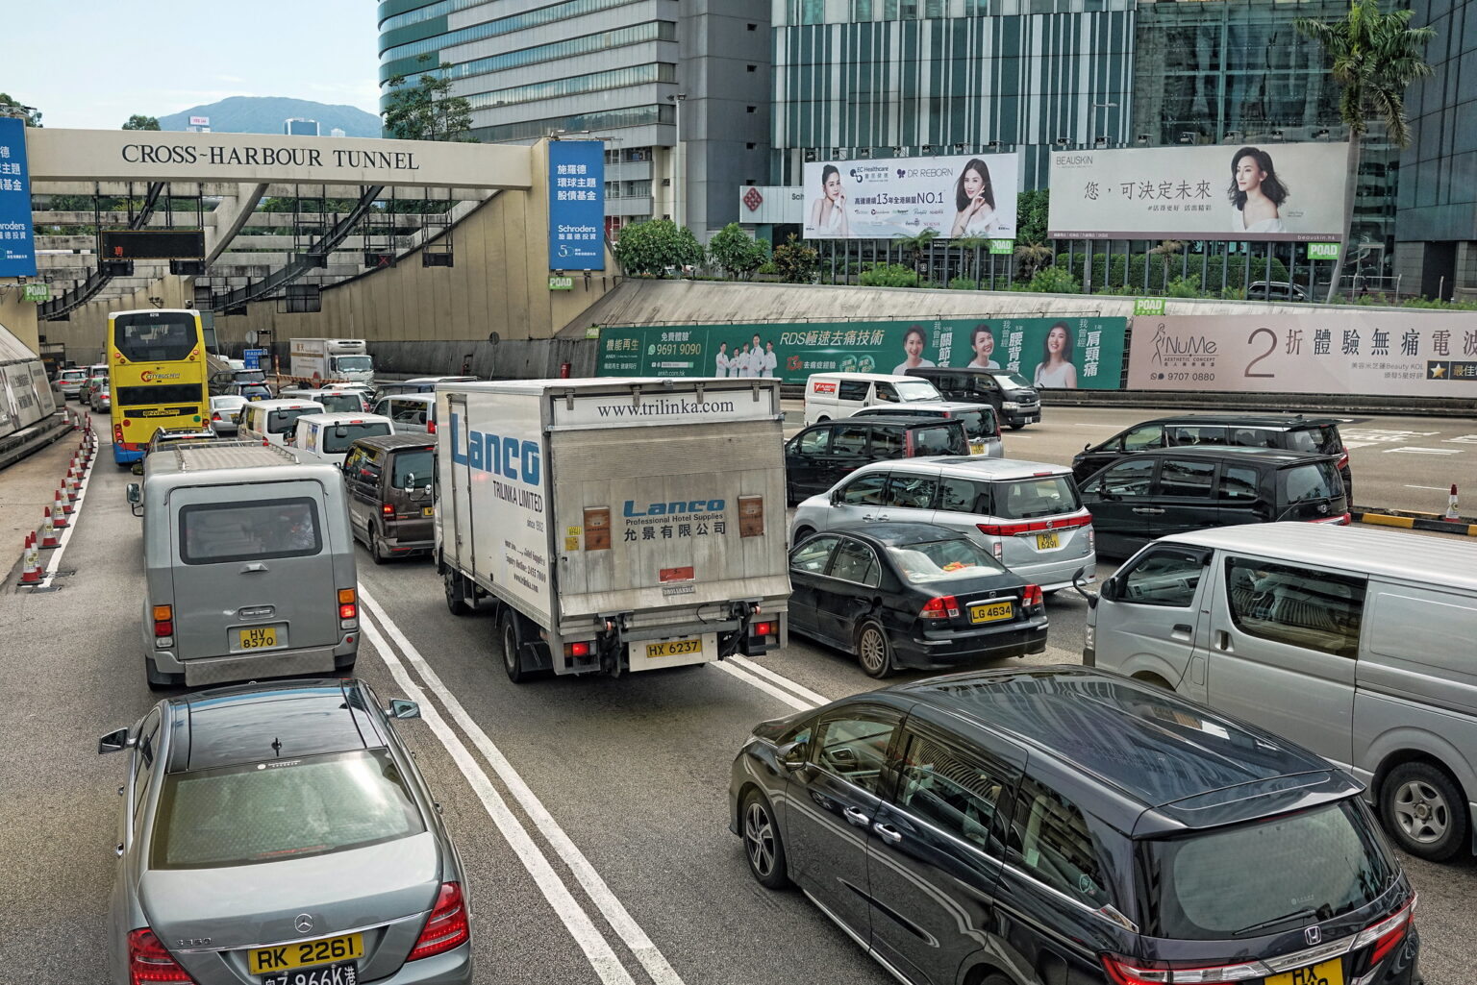
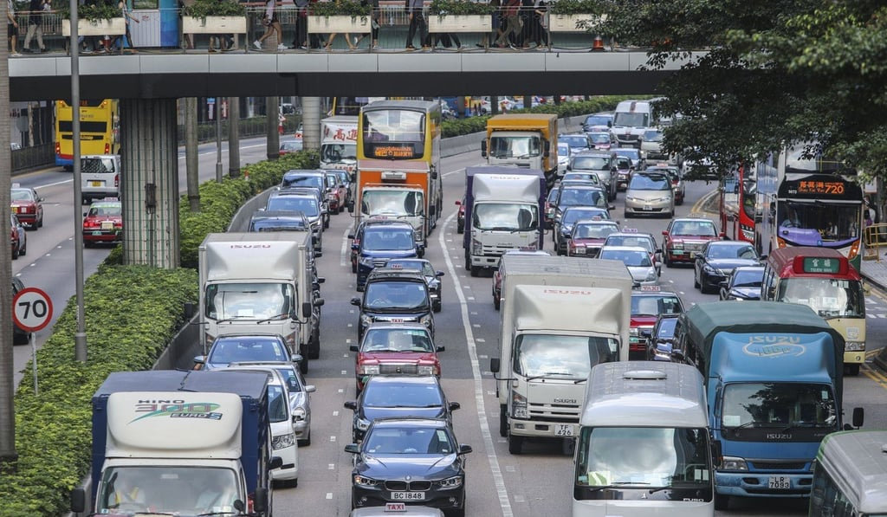
65%
97%
500,000
more carbon dioxide is emitted from private vehicles when compared to the MTR alone
of vehicular traffic is caused by private transport alone
of transportation growth in private transport within 5 years
Notes:
https://www.cityu.edu.hk/cshk/files/PolicyPapers/CSHK%20PP23_ENG.pdf
https://www.td.gov.hk/filemanager/en/content_5018/Figure/Fig5-6.pdf

Slide 7

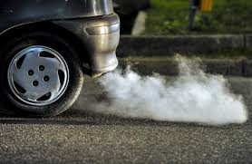
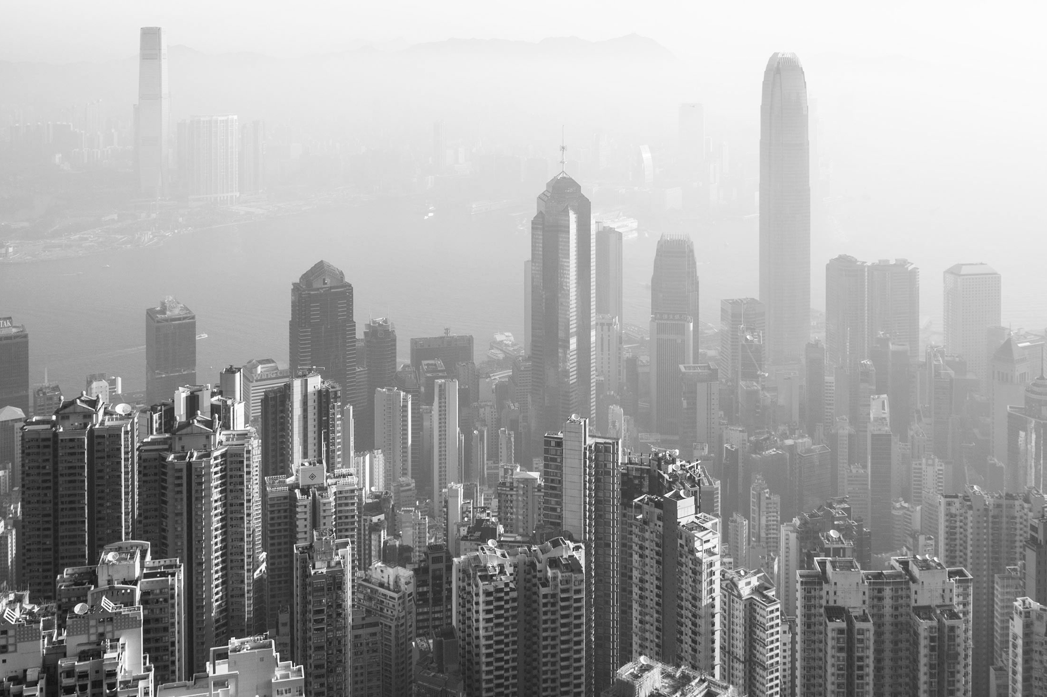
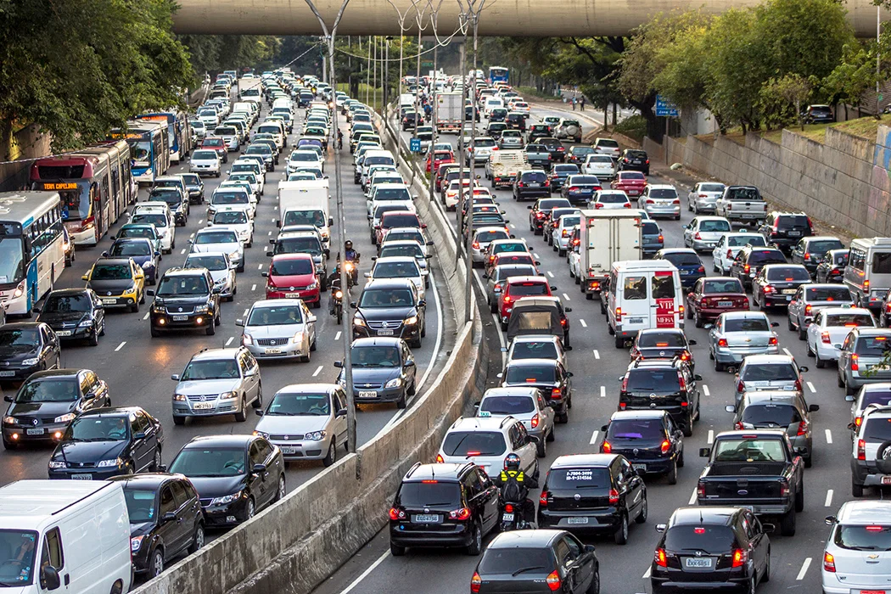
Key Issues
Private Vehicles
Air Pollution
Traffic Congestion
Overreliance on private vehicles
The deterioration of air quality in HK
Slows down road commute

Slide 8
02
Proposal: Our Solution

Slide 9
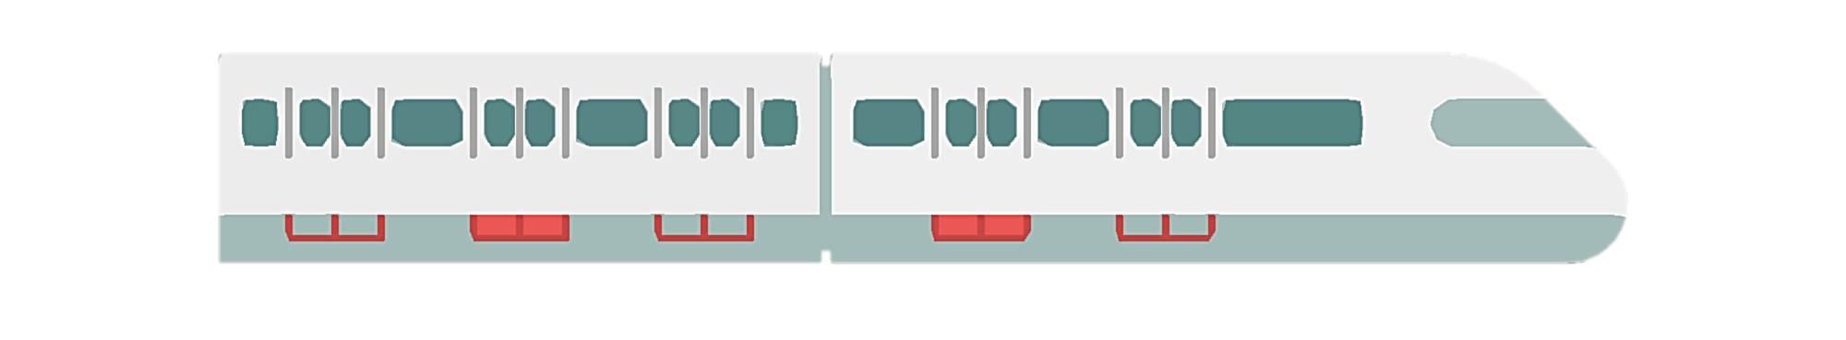
Mission Statement
An app that encompasses the travel needs for a variety of users, to incentivize people to make greener transportation choices
Notes:
App that encompasses travel needs for a variety of user groups to incentivize people to use public transport. We do this by he following process

Slide 10
Key Features
Route Planning
Gamification
With an advanced AI model, we factor in key elements like weather, traffic, rush hour, and accessibility needs to find the fastest and most efficient route to your destination.
Our gamification feature makes green transit fun by rewarding eco-friendly choices. Grow your virtual forest with each sustainable journey and enjoy a sense of progress with every tree planted.

Slide 11
Additional Features
Green Transport
Route Planning
Gamification
Using AI to provide the most efficient routes for both private and public transport
Encouraging green transit through gamification with virtual trees
Infrastructure Improvements
Mobility Inclusive
Carbon Emission Tracking
Catering routes towards those with mobile disabilities to ensure easy travel
Using data analysis to suggest better infrastructure based on route popularity
Tracking carbon emissions with each journey, helping users see their environmental impact.

Slide 12
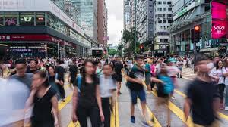
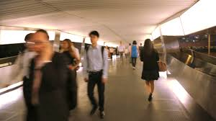
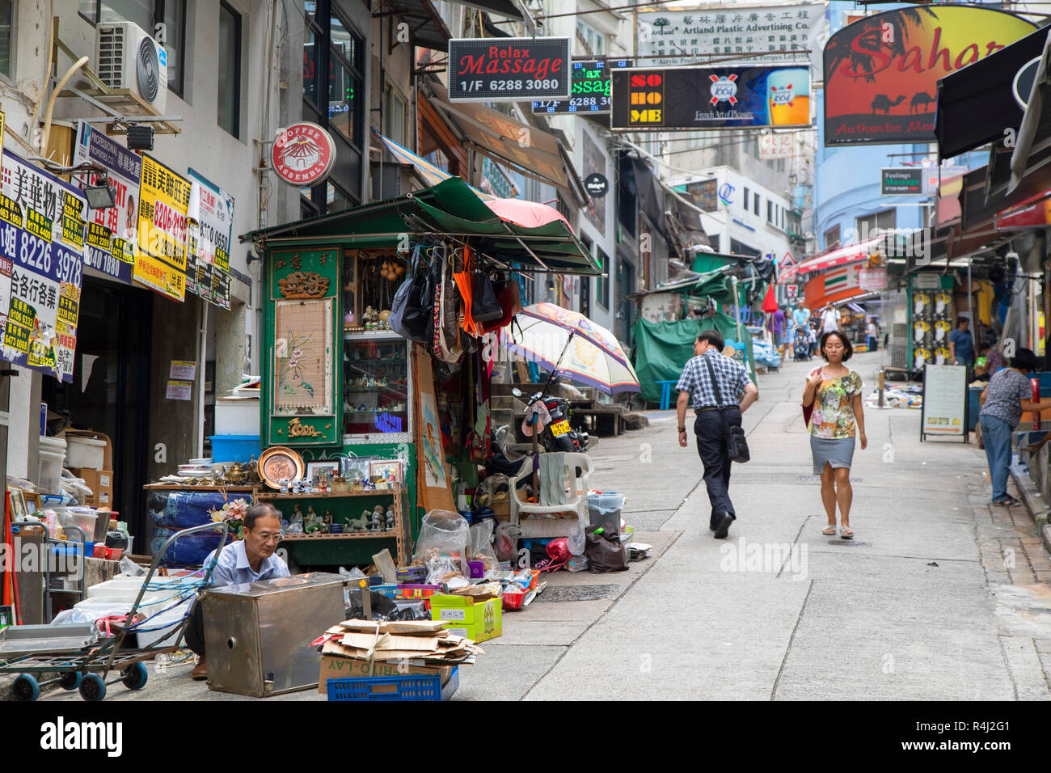
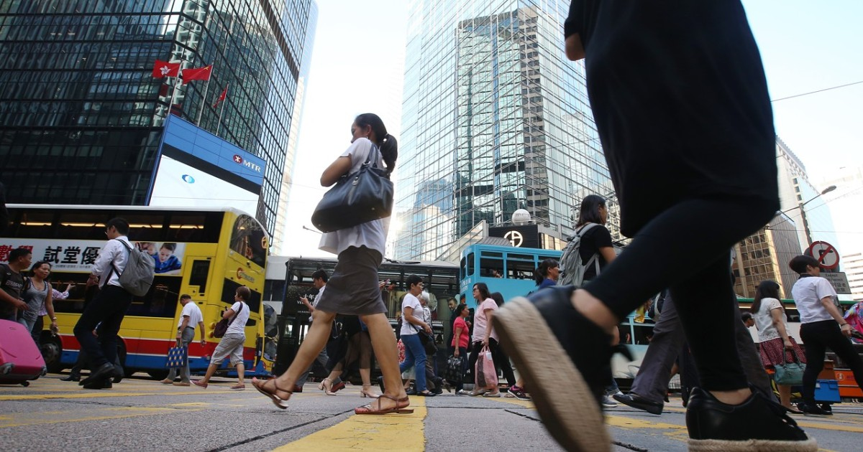
Infrastructure Improvements
Tracking user routes to uncover infrastructural needs

Slide 13
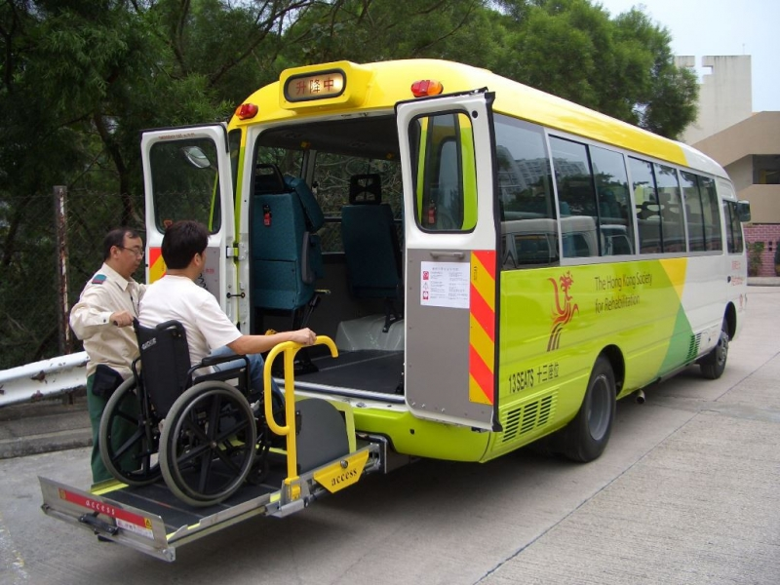
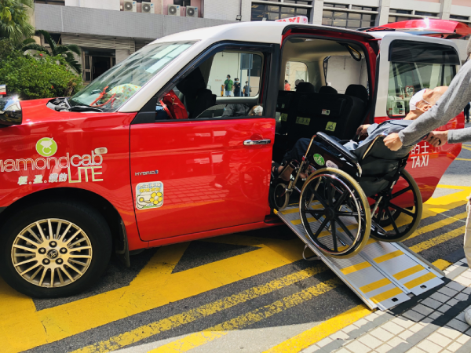
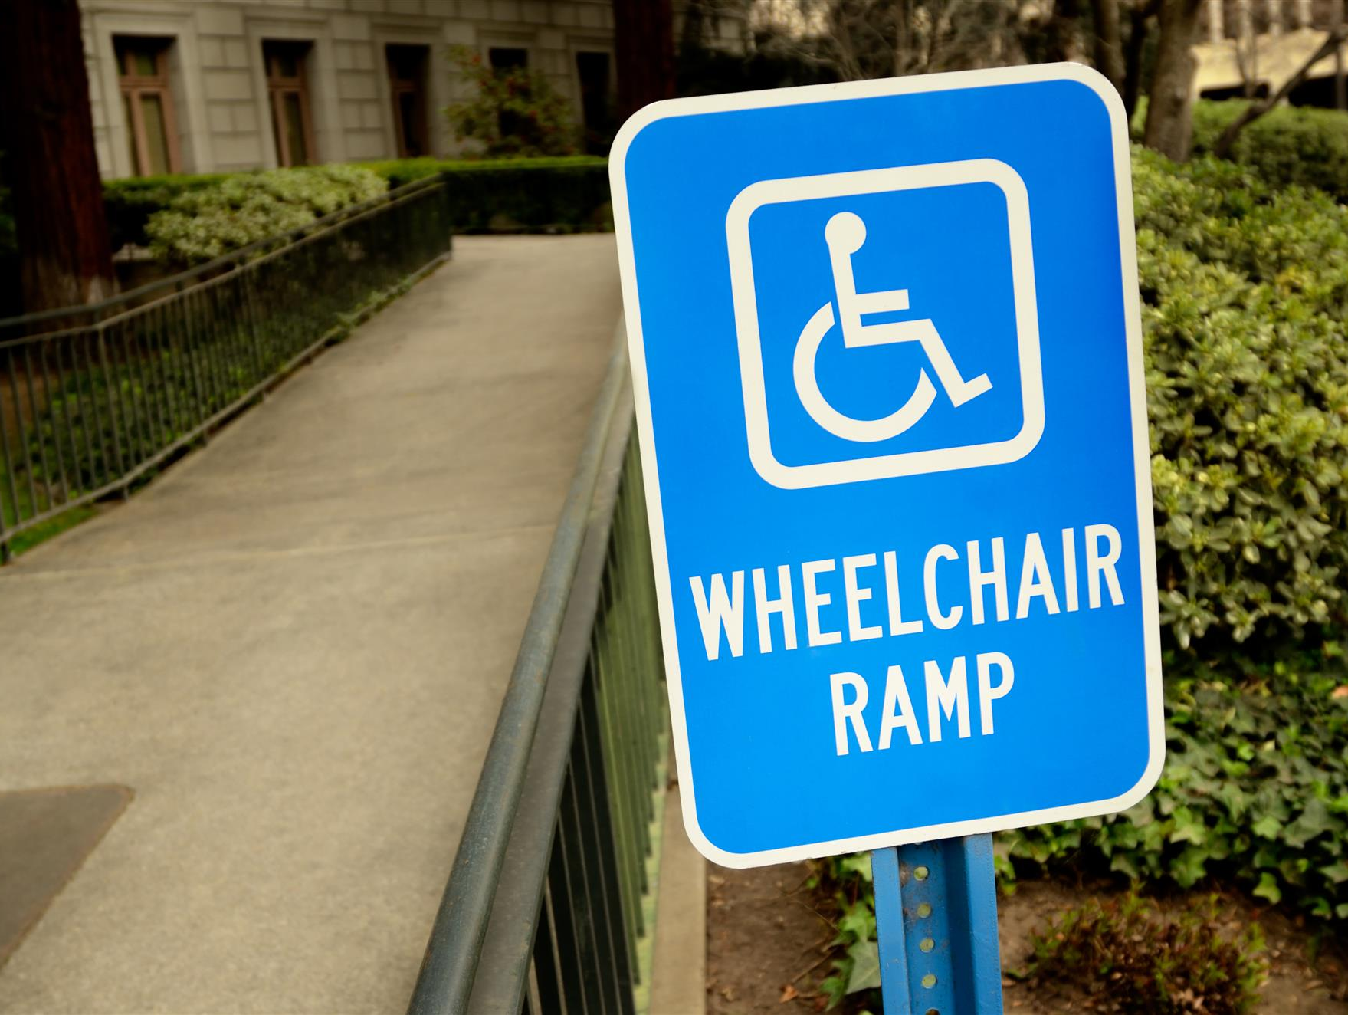
Mobility Inclusivity
Rehab Bus
Diamond Cab
Structural Needs
Includes routing and scheduling of the Rehab Bus
Includes routing and scheduling of the Diamond Cab
Some areas in HK need adaptions to allow for wheelchairs to access

Slide 14
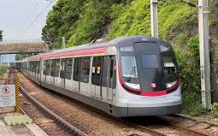
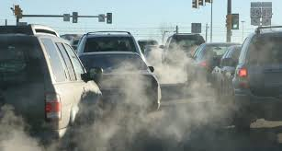
Carbon Emission Tracking
The specific amount of Carbon Emissions reduced will be calculated and projected to the user.
Through quantification of Carbon Emissions, we highlight the severity of the issue to users and provide a virtual sense of satisfaction.

Slide 15
Live Demonstration

Slide 16
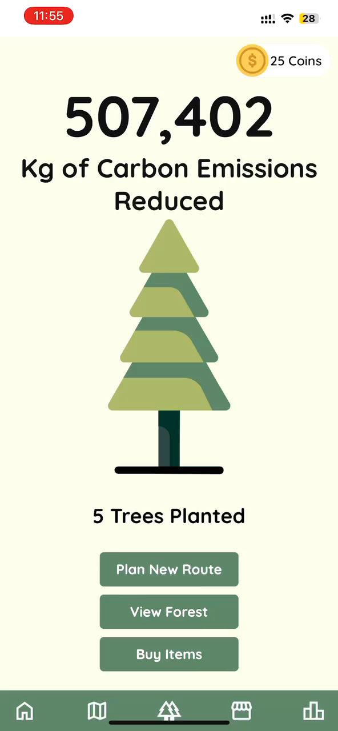

Slide 17
03
Impact: Visualising Change

Slide 18
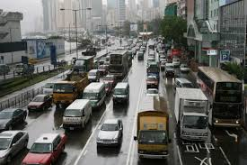
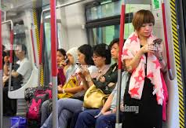
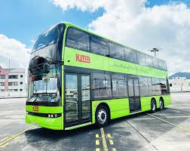
Efficiency & Accessibility
30%
10-15%
45%
Can reduce congestion by up to 30% in urban areas
Real-time information can increase ridership by 10-15%
Public transport is on average 45% more energy-efficient than private cars

Slide 19
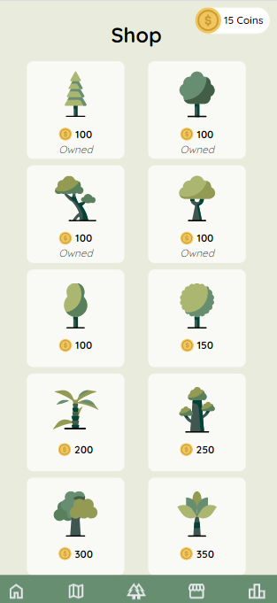
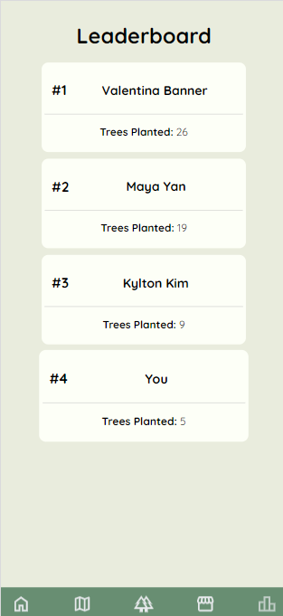
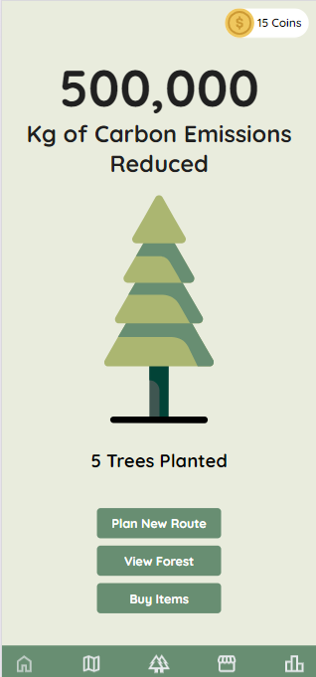
The Power of Gamification
Gamification can bring upon increased motivation and engagement, further incentivizing greener transport choices

Slide 20
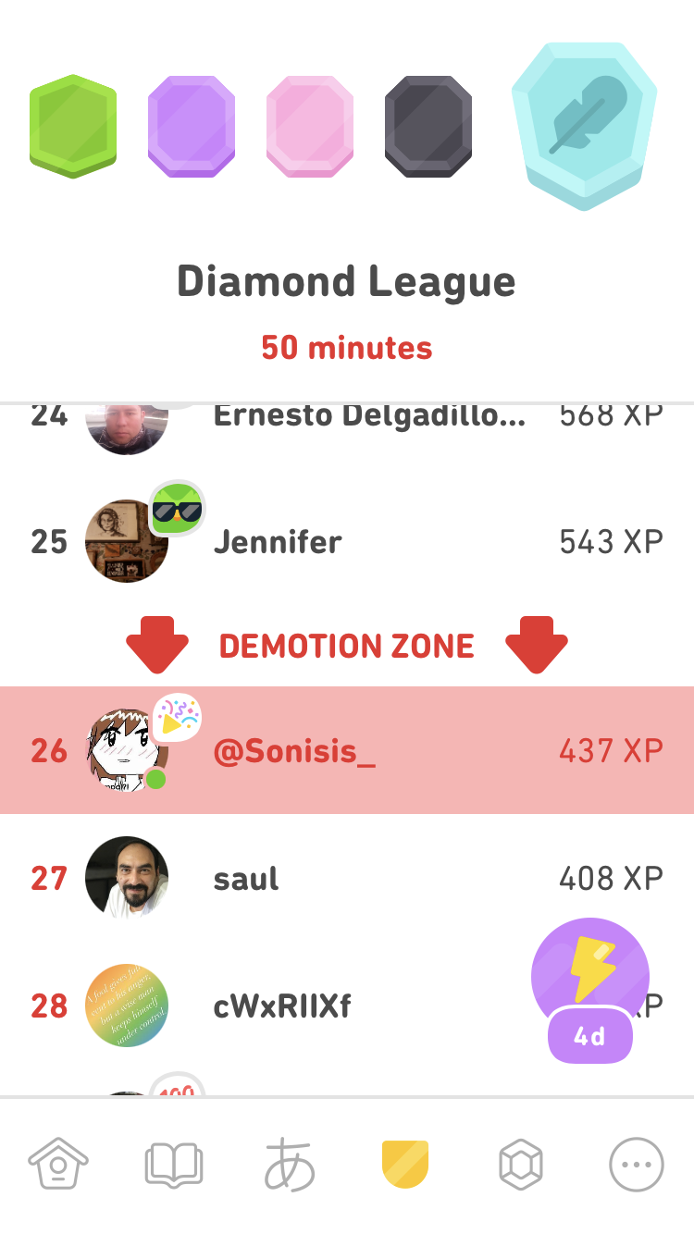
Duolingo
A leading example is Duolingo, with over 500 million online users and 23 billion lessons completed.

Slide 21
04
Conclusion: Moving Forward

Slide 22
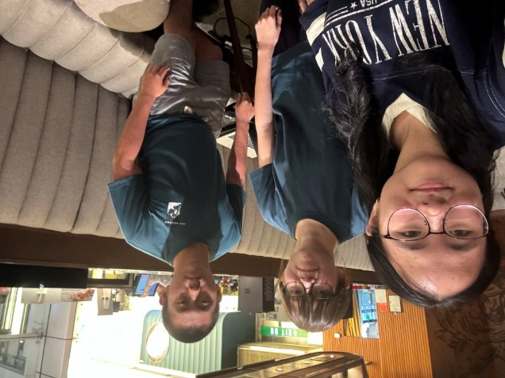
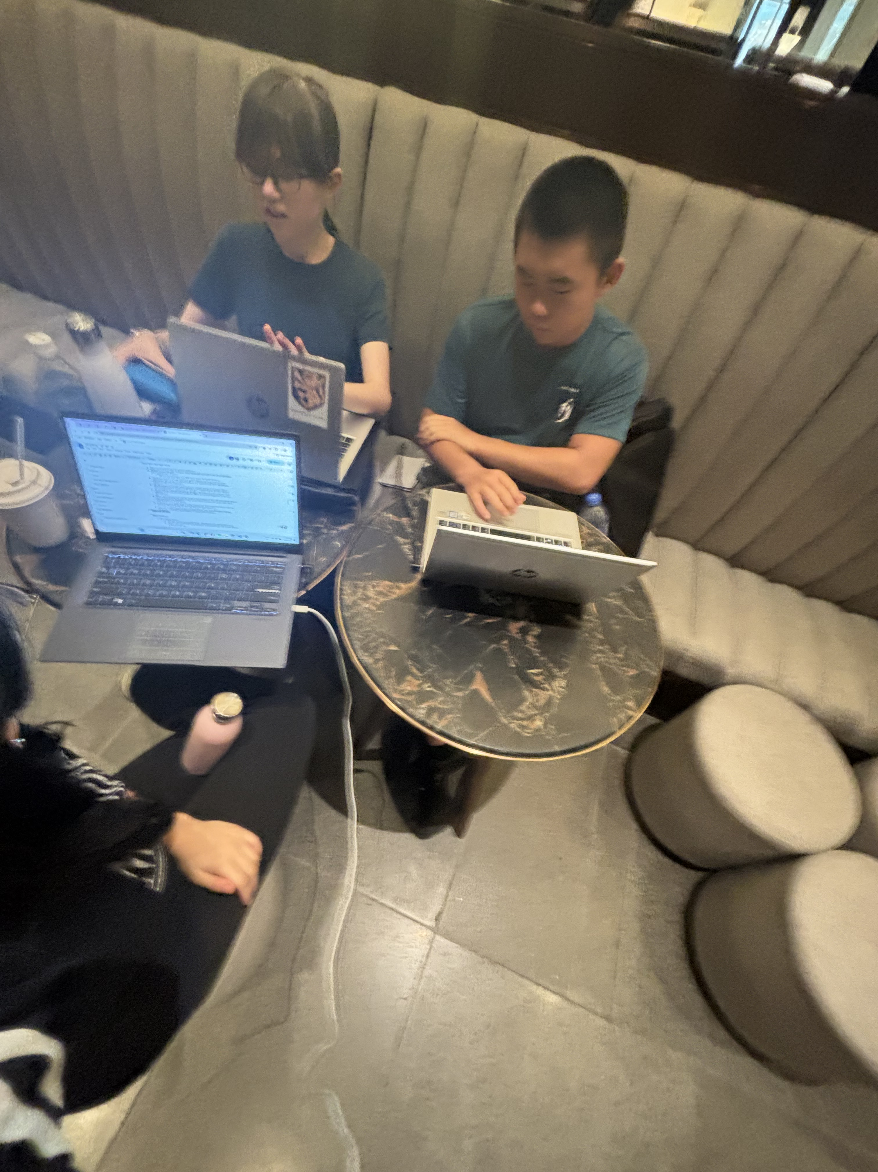
Challenges
Idea Selection
Implementation
What should our project be about? What is the "perfect idea?"
Creating the AI model, App demo, Carbon emission Calculations
Idea Development
Reflection
After the initial submission, what else are we lacking? How can we further enhance our idea?
What is the impact of our idea? How have well have we worked together?

Slide 23
Call to Action

Slide 24
Thanks!
Do you have any questions?
bannev1@kgv.hk
yanm1@kgv.hk
kimk5@kgv.hk
King George V School

